Slide 1

Week 4: Adjacency pairs in Rezonator
Ryan Ka Yau Lai

Slide 2
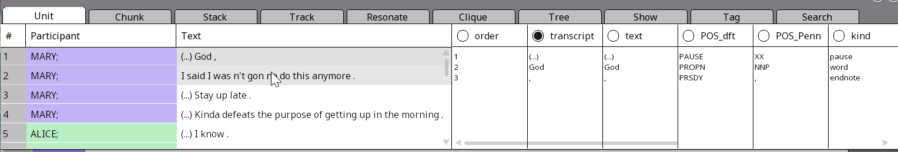
While we’re waiting …
Open SBC007 on Rezonator
Preferably a previously saved version
Open the audio file
Change active display to the transcript field
Note today’s codeword and question on the board
Sit with your group members
Shameless plug: You can still enroll in LING 194 Visualising language in conversational interactions, which I teach in summer!

Slide 3
In this section, we will …
Explore different types of linguistic evidence for TCU completion
Understand the importance of sequence in conversation analysis
Explain the idea of an adjacency pair
Identify question-answer pairs in discourse
Distinguish different pragmatic functions of Q-A pairs
Identify common expansions of the Q-A pair

Slide 4

Question of the day
Identify a question-answer pair in SBC007 and tell me the pragmatic function of the question and answer.
[Please send me a screenshot if possible]

Slide 5
Syntactic, prosodic and pragmatic completion: Ways of arguing for TCU boundaries
Syntactic completion: If the speaker stopped speaking here, will they have produced a complete sentence, or would you expect something to come afterwards?
Prosodic completion: Closure (rising/falling intonation) usually indicates completion, vs. continuing (stable/slight rise/slight fall)
Pragmatic completion: In terms of the meaning of the language produced, does it make sense to stop here are would you expect to hear more?

Slide 6
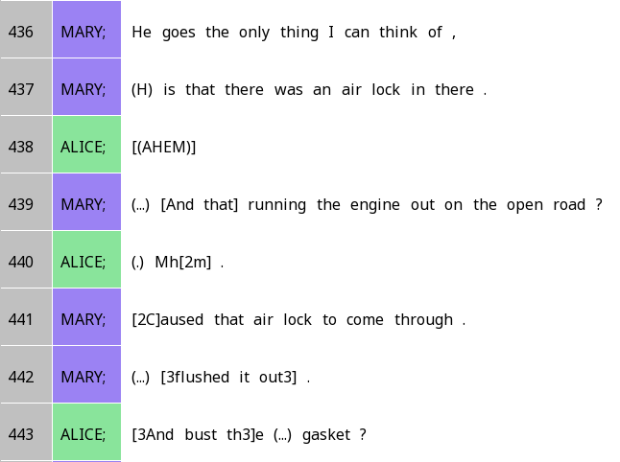

Using linguistic evidence: Why did Alice start speaking in line 443?
Prosodic completion: Falling intonation suggests that the TCU is complete
Syntactic completion: This is a complete sentence, with no indication that something should come after
Pragmatic completion: In terms of the context (explaining what happened with the oil leak + fire), this description seems to be complete

Slide 7
Actions: A central concern of Conversation Analysis
We use language in order to perform social actions
To understand what language means, we need to know what action it performs
What might help you understand actions?

Slide 8

Central insight of conversation analysis
To understand what action an utterance (TCU) is performing, we must look at not just its content, but also when it occurs in the conversation (i.e. sequence)

Slide 9
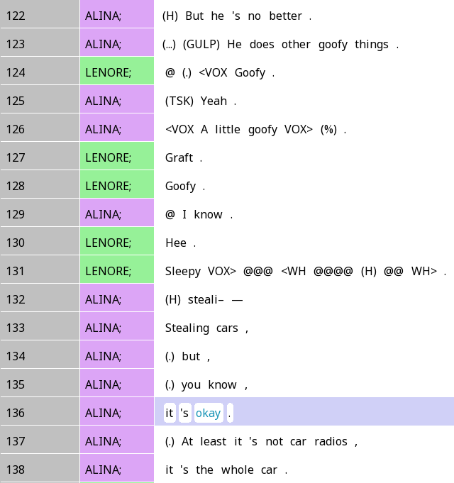
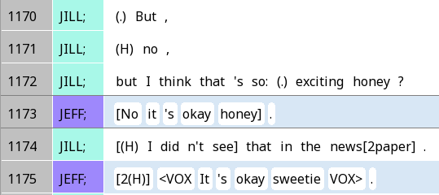
It’s okay …
Although both situations use ‘it’s okay’, the phrase mitigates a negative judgement in the first case, and downplays a positive judgement in the second case.
…

Slide 10
What is an adjacency pair?
A pair of utterances
Belonging to different turns
Appearing next to each other (usually; we’ll discuss exceptions later)
The first pair part (FPP) initiates an exchange; the second pair part (SPP) responds to the FPP

Slide 11
Pair types
For each type of FPP, there is only a limited range of SPPs that make sense
If you give someone an invitation (e.g. Would you like to come to my party?), you don’t expect a greeting (e.g. Good morning)
i.e. the FPP sets up expectations about the SPP that helps us interpret it
Major focus of this week: questions and answers

Slide 12
Question-answer pairs
Question (FPP): An utterance intended to seek information about something
Creates an obligation for the recipient to answer
Answer (SPP): An utterance that gives the information sought by the question

Slide 13
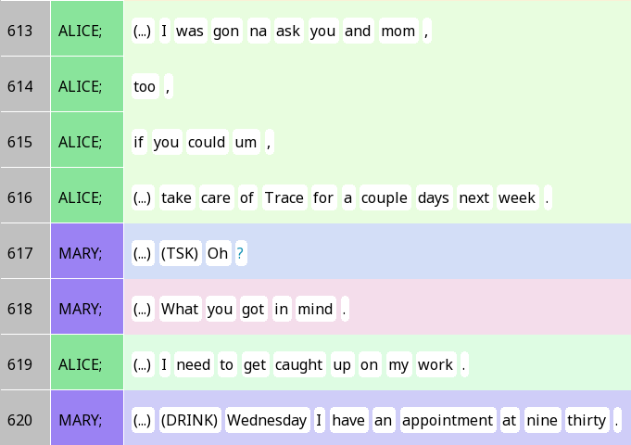
How do you interpret Mary’s action on line 620?
Because Alice’s question is really a request, Mary’s response can be taken as a partial rejection (if Trace needs to taken care of on Wednesday).

Slide 14
What linguistic ‘hints’ tell you that a certain TCU is a question?
Pragmatics
Grammar
Intonation

Slide 15
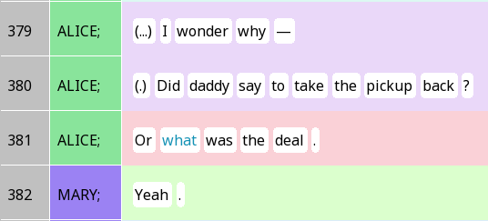
Quick note - polar and content questions
Content question
Polar question
Content question

Slide 16
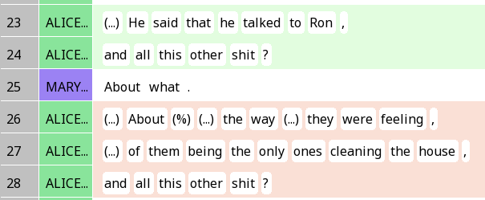
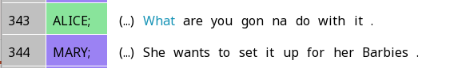
Appeal contour = question?
Both excerpts have a content question, which tend not to be accompanied by an appeal contour (?). By contrast, the first excerpt demonstrates two examples of uptalk, which does not mark questions.
Question: Are some types of question more likely to be accompanied by appeal contour than others?

Slide 17
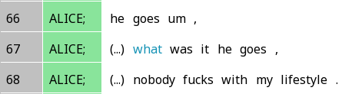
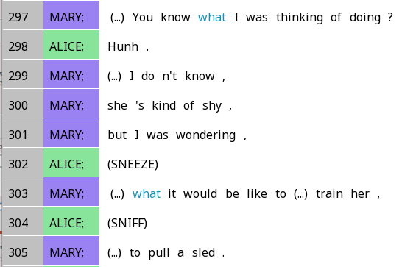
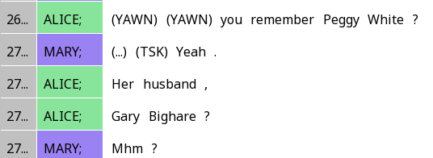
Question grammar = question?
The right extracts contain question words, but they are not exactly questions.
Word search
Question words (what, where, why …)
Inversion (will you instead of you will)
Question tags (isn’t it?)
I am wondering ….
Pre-telling
Telling
The left extract contains questions, but they have no question grammar.

Slide 18
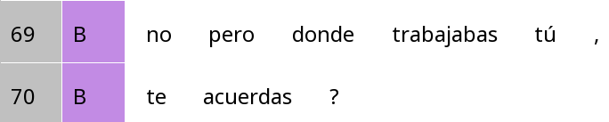
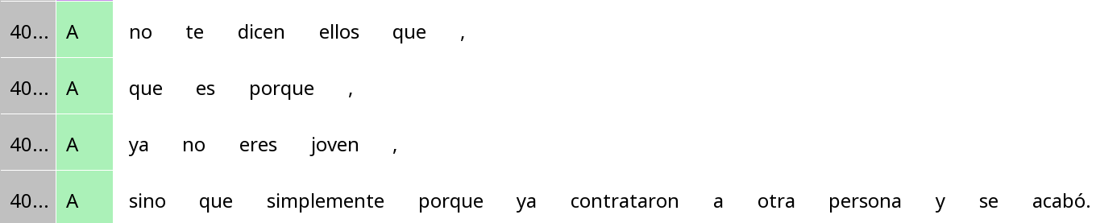
How solid is inversion?
The second extract contains inversion, but it is not question inversion.
No but where worked you,
You remember?
don’t tell you they that,
that it’s because,
you’re not young any more
but simply because they hired someone else and that’s it.

Slide 19
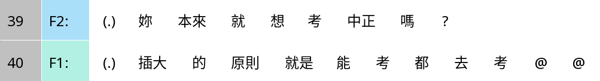
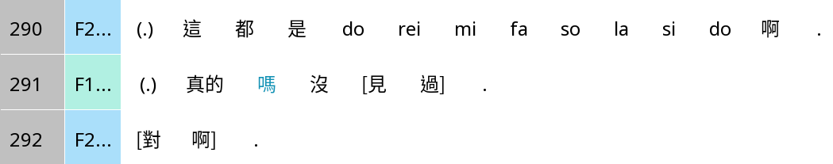
Final particle in Chinese: 嗎 ma
Have you always wanted to take the exam for Chung Cheng ma?
The idea of chādà* is that you go take the exam whenever you can.
*Exam for university transfers in Taiwan
Those are all do re mi fa so la si do.
The second extract contains ma, but it is not a real question, just commenting on how unbelievable something is.
Really ma, I’ve never seen that.
Yeah.

Slide 20
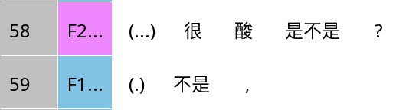
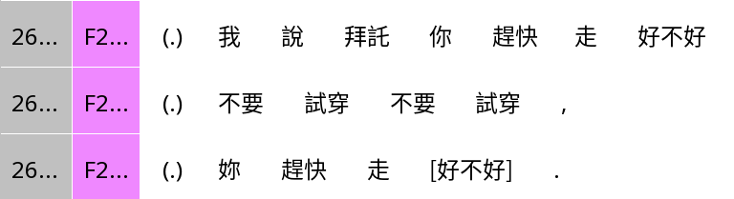
A-not-A (e.g. is-isn’t)
Very sore, is isn’t?
Isn’t.
I said please hurry up and go good-not-good
Don’t try it on, don’t try it on
The ‘good-not-good’ in the second extract is used to intensify the request, rather than ask a question.
Hurry up and go good-not-good

Slide 21
Ultimately …
Pragmatics/meaning is the ultimate judge
Is the speaker trying to get at some response from the listener?
Is the listener orienting to the TCU and providing a response?
Of course, syntax/prosody are always good as a first pass!

Slide 22
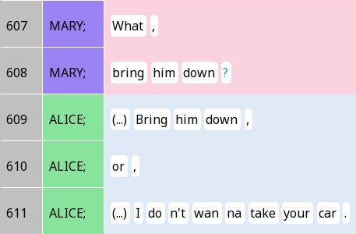
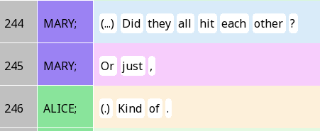
Response formats
Repetition of elements of the question
Response token (yes/no etc.)
Degree adverbial

Slide 23
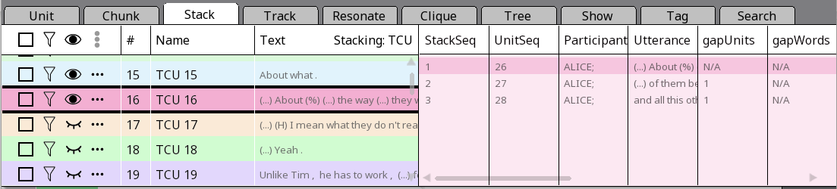
Show/hide
Show/hide ALL stacks
Show/hide individual stacks

Slide 24
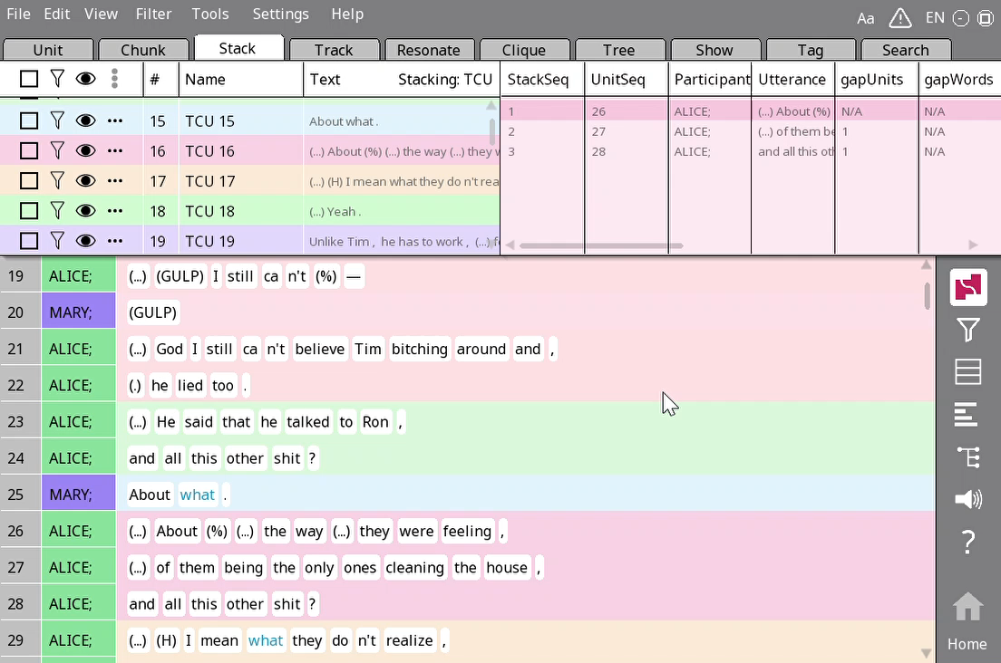
Hiding and showing stacks
Hide all stacks
Show the TCUs corresponding to a question and an answer

Slide 25
Your turn!
Find
Find a Q-A pair in SBC007
Show
Show the corresponding TCU stacks
Explain
Explain how you recognised the first pair part as a question
Explain
Explain how you recognised the second pair part as a response

Slide 26
Q: Did all of your questions appear to be eliciting information from the listener?

Slide 27
Information-seeking

Slide 28
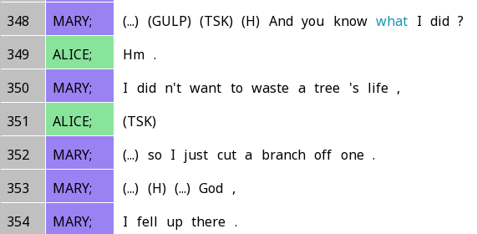
Pre-telling

Slide 29
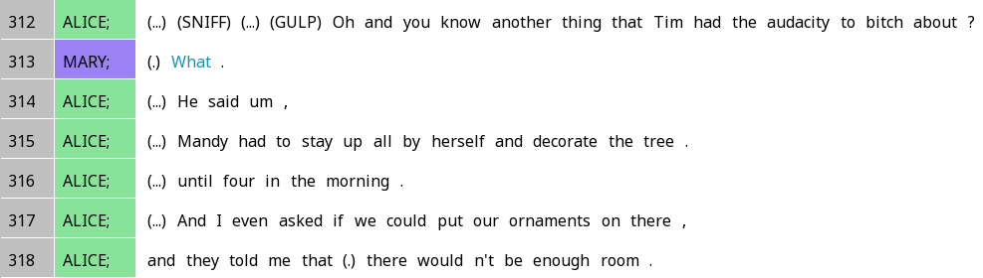
Pre-telling

Slide 30
Request

Slide 31
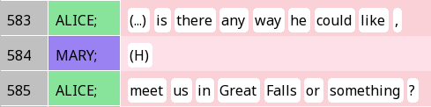
Invitation

Slide 32
Insert sequences
What is Mary doing in 617-618?

Slide 33
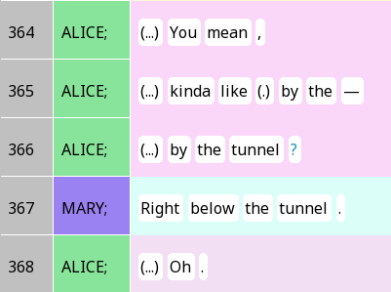
Sequence closing thirds (a.k.a. minimal post expansion)

Slide 34
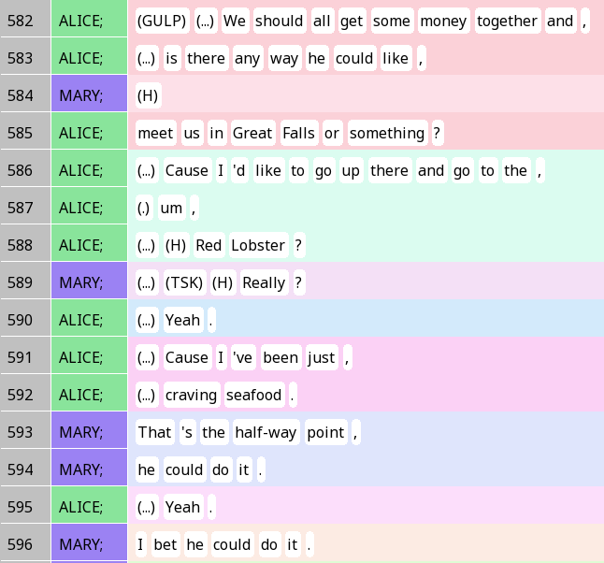
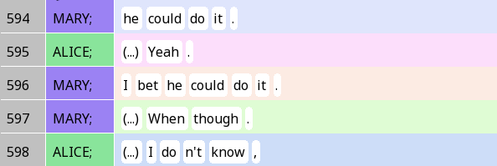
Insert sequence + Non-minimal post-expansions

